Slide 1

WELCOME TO THE EXPERIMENT!
Task: Squircle Task
This Experiment is related to color perception of Red and Blue.
You will be presented with 8 circles in the middle in varying mixture of Red and Blue colors
We would like to ask you to choose whether the average of those colors is closer to Blue or Red.
You will see an example and further explanations in the next page.
Press the in order to continue
Spacebar
Notes:
1

Slide 2
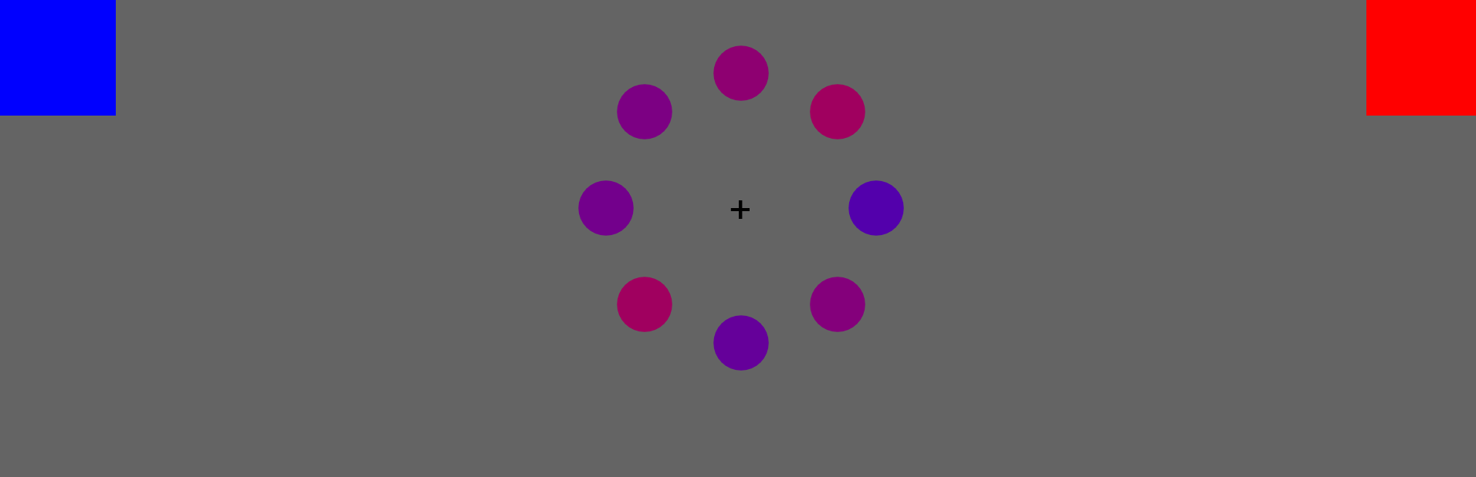
You will see the stimuli for a brief time, you will make your decision by moving your cursor to either the blue or the red box.
You do not need to click in any point in this experiment, just move your cursor and it will choose automatically.
After you choose the color, move the cursor back to the white box at the lower center of the screen.
In the next page you will see a short clip as to how you should proceed.
Spacebar
Press the in order to continue
Notes:
1

Slide 3
Only in the first block you will receive feedback as follows: Wrong or Correct
You will have 5 seconds to respond for each trial
Please, try to be as fast as possible while trying to give correct answers.
Training will continue until you reach 60% accuracy in the feedback phase
Please do not stop mouse movement during trial.
You can start the Experiment
Whenever you are ready
Good luck ☺
Spacebar
Press the in order to continue

Slide 4
Break Time!
Break :
Out of 9 breaks
Your Cumulative Average Accuracy
Your Cumulative Average Reaction Time
Spacebar
Press the in order to continue

Slide 5
Please do not stop mouse movement !

Slide 6
This task has been completed and finished successfully.
Everything is now finished.
The assistant will inform you with details.
Thank you for your participation!
Spacebar
Press the in order to exit

